Slide 1
CSV Files and Jupyter Notebooks

Slide 2
Comma separated variable (CSV) files are a popular format for data files
Each row of the file contains one record
A special character such as a comma is used to separate column values
The first row may contain the names of the columns
Name,City,Country
Seattle-Tacoma,Seattle,USA
Dulles,Washington,USA
Heathrow,London,United Kingdom
Schiphol,Amsterdam,Netherlands
Changi,Singapore,Singapore
Pearson,Toronto,Canada
Narita,Tokyo,Japan

Slide 3
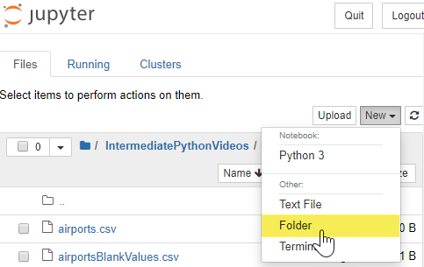
How does your notebook find the file?
You need to upload the files to Jupyter
It is common practice to create a subfolder to hold your data files
Create a folder for your data files by selecting New | Folder

Slide 4
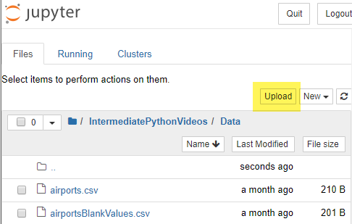
Upload the file to access it from notebooks
Navigate to the folder and upload the files you want to access from your notebooks by selecting Upload

